Slide 1
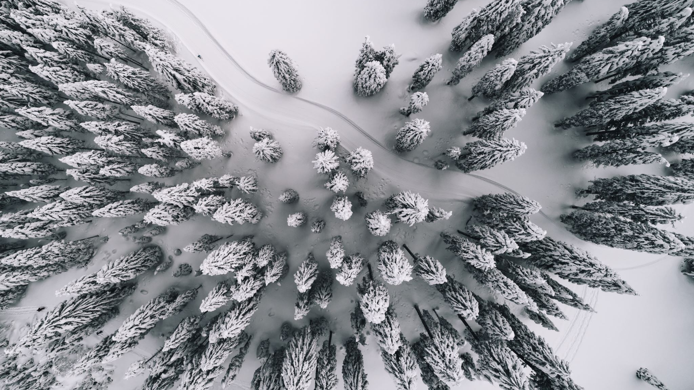
Kenora Nordic and Biathlon Club
Light the Trails project at Mount Evergreen
2022-23

Slide 2
KNBC Light the Trails Project Background
Project Description: 6 kms lit trails, including para loop, Frank Symonds, Two Towers, Matoos, and Jackrabbit
Phase 1 FedNor $500,000 approval June 2022
Phase 2 NOHFC $490,000 approval August 2022

Slide 3
Estimated KNBC Portion $175,000
KNBC
$65,000
FedNor
$500,000
KNBC $110,000
NOHFC $490,000

Slide 4
Fundraising Targets $175,000
Corporate/Businesses
$45,000
Other Funding
$85,000
Individuals/Buy a Pole Campaign
$50,000

Slide 5
Amount raised to date $52,755
Other Funding: Kenora & Lake of the Woods Regional Community Foundation $10,000.00.
Other Funding: City of Kenora – January 2023
Other Funding: Kenora Hospitality Alliance – 17,500
Corporate/Businesses Sponsorship to date:
Cabin Country Realty $10,000
Hardwear Company $ 4,000+
Individuals/Buy a Pole Campaign
$1250/pole x 5 = $11,255.00

Slide 6
KNBC Light the trails Project-Timing
Fall: KNBC AGM fall 2022 Launch Event Presentation
Fall: CCSAM linkages
Fall: buy a pole and corporate campaign
December: Winter Solstice Fundraising event
Winter: Hydro one grant writing 2023

Slide 7
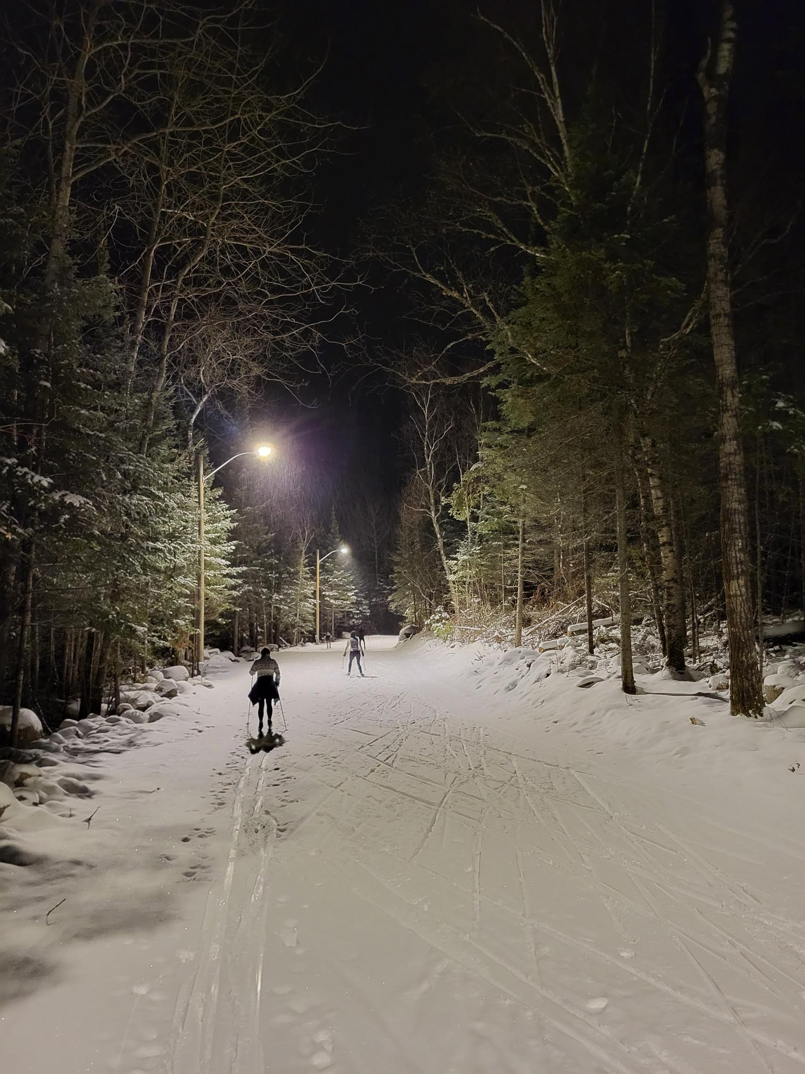
Phase one completed!
We have produced almost daylight conditions on over 3k of trails for the 2022-2023 ski season.
By 2023-2024 season we will have 6km of lit trails allowing night racing and training for athletes and a much safer and welcoming trail system for recreational skiers.

Slide 8
Phase one lighting
Changing the game for coaches

Slide 9
What do we need from CCSAM?
Enthusiastic support, talking it up, generating excitement about the lights and the fundraising campaign
Suggestions re: Manitoba businesses to target and offers to contact them
Other ideas/other assistance
Post the links so people can donate at Zone 4, along with the story to the CCSAM website.
Email CCSAM members about the initiative.

